Slide 1
Manning School of Business
Enterprise Bank API / Middleware
Gap Analysis
ANDREW MEJIA, ASHIKA FNU, AJAY KUMAR BOLLA

Slide 2
PRESENTATION Agenda
01
INTRODUCTION & OVERVIEW
02
CURRENT ARCHITECTURE
03
Communicator Open Overview
04
VENDOR Overview / Recommendation
05
Bank Feedback / Insights
06
Communicator Open Gap Analysis
07
Conclusion / Action Items
Manning School of Business

Slide 3
Enterprise Bank API / Middleware Gap Analysis
Overview:
Enterprise Bank is working on a roadmap for their data architecture / infrastructure that will involve restructuring some of their integrations and taking on new vendors to assist in the planning and implementation.
As a first step, Enterprise Bank has enlisted the help of students from the Manning School of Business to help investigate potential vendors and present a gap analysis on Fiserv’s Communicator Open. The goal of this project is to provide Enterprise Bank with the knowledge and insights required to make meaningful decisions around their architecture, enabling them to enhance the customer experience and improve efficiency of their operations.
Transition Note:
The topics covered in this presentation are high level, additional details and documentation will be available in the appendix and separately via documents shared by the Manning School of Business.

Slide 4
PRESENTATION Agenda
01
INTRODUCTION & OVERVIEW
02
CURRENT ARCHITECTURE
03
Communicator Open Overview
04
VENDOR Overview / Recommendation
05
Bank Feedback / Insights
06
Communicator Open Gap Analysis
07
Conclusion / Action Items
Manning School of Business

Slide 5
Enterprise Bank’s Current Core Banking Data Architecture
Customer-Facing and Transactional Services
Operational and Strategic Functions
Core Infrastructure

Slide 6

Understanding Current Core Banking Data Architecture
V
Core Infrastructure:
Customer-Facing and Transactional
Services:
Operational and Strategic Functions:
V
V
Financial & Risk Management: Financial health and risk tools.
Data Warehousing & BI: Storage and analysis systems for decision-making.
Fraud, AML Compliance: Fraud prevention & regulatory compliance
Content Management: Organizational document and content management.
Treasury Management: Liquidity and financial risk management.
Branch Automation: Technologies for branch operations efficiency.
Lending Solutions: Loan process support systems.
Core : Central integration system for banking services.
Customer Notification: Specific middleware component for notifications.
Debit Solutions: Involving debit card services and related transaction processing.
IP and FOS: Item processing and Fiserv Output Solutions
Digital Channels: Encompasses online banking, mobile banking, and other digital customer interfaces.
Payment Solutions: Including Automated Clearing House (ACH) transactions, check processing, and wire transfers.
Digital Account Opening: Service to allow opening of customer accounts.

Slide 7
PRESENTATION Agenda
01
INTRODUCTION & OVERVIEW
02
CURRENT ARCHITECTURE
03
Communicator Open Overview
04
VENDOR Overview / Recommendation
05
Bank Feedback / Insights
06
Communicator Open Gap Analysis
07
Conclusion / Action Items
Manning School of Business

Slide 8
FISERV Communicator Open
OVERVIEW
Brief Description: Communicator Open from Fiserv, formerly Communicator Advantage, simplifies integration for financial institutions that use Fiserv account processing platforms, enabling them to customize their technology ecosystems, readily access third-party fintech capabilities and pursue open finance strategies.
Features & Functionality:
Normalized APIs: Enable 'once-and-done' integration, greatly simplifying access to third-party fintech solutions​​.
Sophisticated Technologies: APIs are cloud-native RESTful microservices, utilizing containerization, elastic orchestration, and an open-source framework infrastructure​​.
Industry-Specific Services and Standards: Compliance: Adheres to financial services industry standards and supports a wide range of banking functions​​.
Scalability & Capability: Processes billions of transactions annually with high accuracy, reliability, and millisecond response times​​.
Value add to banking Infrastructure:
Integration of Third-Party Innovations: Enables quick integration to leverage emerging opportunities and create distinctive products​​.
Enhanced Digital Experiences: Offers personalized, real-time, frictionless digital experiences for account holders​​.
Real-Time Analytics and Streamlined Processes: Facilitates relevant, real-time analytics for decision-makers and streamlines internal operations​​.
Extending IT Asset Value: Adds new capabilities to existing IT assets, helping execute the organization's unique vision​​.
Cost-Effectiveness: Utilizes reusable, out-of-the-box components that help meet business requirements and simplify complex integration needs​​.
Sources: Fiserv Communicator Open

Slide 9
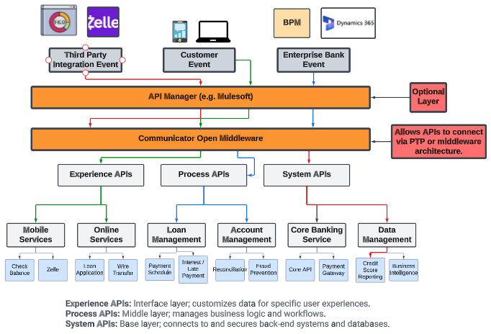
Fiserv Communicator open
Middleware architecture
Middleware Role:
Acts as an integrative bridge between diverse banking applications, facilitating seamless data and service flow.
Communicator Open Functionality:
Serves as middleware, connecting bank's core systems with operational and customer services.
Normalizes integrations with restful APIs.
Key Advantages:
Streamlines operations and reduced complexity.
Enhanced security and compliance with banking standards.
Simplification of architecture yields performance and maintenance gains.

Slide 10
Fiserv Premier SOA Vs Communicator Open)
Feature/Functionality | Premier SOA (Fiserv) | Communicator Open (Fiserv)
Integration with Fiserv Account Processing Platforms | ✓ (Designed to integrate with other Fiserv solutions)​​ | ✓ (Simplifies integration for financial institutions using Fiserv account processing platforms)​​
Customization of Technology Ecosystems | ✓ (Allows clients to aggregate data from multiple sources, simplifying workflows)​​ | ✓ (Enables customization of technology ecosystems)​​
Access to Third-Party Fintech Capabilities | ✓ (Open integration to both Fiserv and third-party applications)​​ | ✓ (Provides once-and-done integration for easy access to third-party fintech)​​
Support for Open Finance Strategies | ✓ (Supports open banking strategy through standardized APIs)​​ | ✓ (Pursues open finance strategies)​​
Cloud-Native RESTful Microservices | - | ✓
Containerization and Elastic Orchestration | - | ✓
Infrastructure Based on Open-Source Framework | - | ✓
Industry-Specific Services and Standards | ✓ | ✓
High Scalability and Fast Response Time | ✓ | ✓ (Processes billions of transactions annually with fast response time)​​
Personalized, Frictionless Real-Time Digital Experiences | - | ✓
Relevant, Real-Time Analytics Experiences | - | ✓
API reuse to reduce complexity | - | ✓

Slide 11
Business Process Managers (BPM) vs Communicator Open
User Interface
Communicator Open:
Steeper learning curve for UI / UX.
Customization is more technical.
Has more broad use case so may be missing functionality from BPM.
Business Process Manager:
Designed for bank staff ease-of-use.
Highly intuitive interface.
Gentler learning curve.
Extensive customization for specific banking processes.
Simplified step-by-step workflows for easy navigation.
Key Takeaway:
Communicator Open emphasizes integration and technology, potentially affecting UI/UX compared to BPM.
BMP prioritizes user-friendliness, offering an intuitive interface tailored to banking tasks.

Slide 12
PRESENTATION Agenda
01
INTRODUCTION & OVERVIEW
02
CURRENT ARCHITECTURE
03
Communicator Open Overview
04
VENDOR Overview / Recommendation
05
Bank Feedback / Insights
06
Communicator Open Gap Analysis
07
Conclusion / Action Items
Manning School of Business

Slide 13
Vendor Overview
Solution Vendors
Introduction: Solution vendors are specialized in providing integrated solutions, working directly on integration projects for banking technologies.
Vendor Highlights:
API PEOPLE: Expert in API managed services and middleware solutions, focusing on integrating various banking systems. Great feedback received from Banc of California
PORTX: Specializes in offering API managed services and middleware integration tailored for financial institutions. They are cloud-centered so may be difficult to integrate with on-prem.
Key Offerings:
These vendors excel in creating custom solutions for complex banking system integrations, ensuring seamless operation and connectivity.
Integration Expertise:
Have extensive experience offering integration services to banking and fintech customers, specifically those using the Fiserv suite of software.
Strategic Impact:
Their services are crucial for banks aiming to modernize their infrastructure and improve interoperability between different banking applications and services.

Slide 14
Vendor Recommendation
Solutions Vendor
Introduction: API PEOPLE has built a reputation for quality work, dependable support and managed services and expertise in banking industry, including Fiserv customers.
Why API PEOPLE?:
Proven Expertise: API People have extensive background working with Fiserv customers.
Positive Feedback: During our interviews with banks, we received very positive feedback about API People from Banc of California.
Customized Solutions: API People provides custom tailored solutions that involve a thorough discovery phase to ensure quality implementation.
Key Strengths:
Fiserv integrations are API People’s core competency. They will work directly with Fiserv on implementing Communicator Open.
Platform agnostic, will work around Enterprise Bank’s integrations rather than requiring additional products or reintegration.
Strategic Advantage:
Beyond just integrations, API People also advises on best practices that will lead to cost effective, performant and reliable integrations.

Slide 15
Vendor Overview
API & Middleware Vendors
Introduction: API/Middleware vendors provide essential tools and platforms for connecting and managing data flow between various banking systems.
Vendor Highlights:
DENODO / Fiserv Open Data: Deliver a data virtualization platform for efficient data integration and management.
MULESOFT: Offers additional layer of abstraction in API architecture to improve integration implementation and maintenance.
JIFFY.AI: Specializes in automation solutions with a focus on AI and machine learning, enhancing middleware capabilities.
Key Features:
These vendors focus on scalable, secure API and middleware solutions that enable data normalization, real-time processing, and system integration.
Compatibility and Flexibility:
Designed to seamlessly integrate with a variety of banking systems and fintechs, ensuring adaptability and resilience in the rapidly evolving digital landscape.
Strategic Benefits:
Facilitate a more agile and interconnected banking ecosystem, paving the way for digital transformation and enhanced customer experiences.

Slide 16
Vendor Recommendation
API/Middleware Vendor
Introduction: MuleSoft provides a reliable, performant and user-friendly API layer that eases in development of integrations.
Why MuleSoft?:
Development : Their interface for development is user friendly, allowing for seamless integrations of new APIs.
Recommended: Highly recommended by other banks, in addition to solution vendors we spoke to.
Scalability: Offers scalable solutions that adapt to banking's dynamic requirements.
Compatibility: Ensures seamless integration with a diverse range of fintech applications and systems.
Key Strengths:
Facilitates easy and secure data exchange between disparate systems.
Enables rapid development and deployment of new banking services.
Strategic Benefit:
Opting for MuleSoft means investing in a future-proof infrastructure, capable of evolving with technological advancements and customer expectations. MuleSoft is parented by Salesforce, so has Enterprise quality and reliability.

Slide 17
PRESENTATION Agenda
01
INTRODUCTION & OVERVIEW
02
CURRENT ARCHITECTURE
03
Communicator Open Overview
04
VENDOR Overview / Recommendation
05
Bank Feedback / Insights
06
Communicator Open Gap Analysis
07
Conclusion / Action Items
Manning School of Business

Slide 18
Bank Insights
Insights from interviews with banks
Bank of Tampa (BoT):
Initially sought more autonomy from Fiserv.
Valued Communicator Open for its middleware capabilities and third-party integrations, notably with Microsoft Dynamics CRM.
Partnered with Clarium and MuleSoft for integration, citing the high quality and ease of use​​​​.
At this stage, the Bank of Tampa is primarily concentrating on establishing its foundational structure. In the future, it plans to utilize various features of the 'Communicator Open' platform more extensively.
Are working on internal process to test APIs via Postman to minimize friction when partnering with new Fintechs.
Banc of California:
Needed cloud-compatible solutions, leading to the adoption of Communicator Open.
Appreciated the shift from SOAP to RESTful APIs, enhancing their cloud-based operations.
Overcame initial integration challenges by partnering with API People, leveraging their expertise for smoother implementation and scalable API structures​​​​.

Slide 19
Bank Recommendations
Recommendations from interviews with banks
Recommendations from Bank of Tampa:
Consider independent integrators like Clarim for more control over technology implementations.
Invest in robust middleware solutions like MuleSoft for quality and ease of use.
Leverage Communicator Open to reduce reliance on a single vendor and enhance third-party integrations.
Fiserv had to adjust their APIs due to issues identified. They were satisfied with Fiserv’s level of support and SLAs to their requests to convert SOAP to RESTFUL APIs.
Recommendations from Banc of California:
For cloud-based banking operations, embrace the RESTful nature of Communicator Open for efficiency and modern integration.
Partner with solution vendors like API People to overcome integration challenges and establish reusable API structures.
Implement robust security and governance measures around Communicator Open to ensure data security and compliance.
Fiserv had to adjust their APIs due to issues identified. They were satisfied with Fiserv’s level of support and SLAs to their requests to convert SOAP to RESTFUL APIs.

Slide 20
PRESENTATION Agenda
01
INTRODUCTION & OVERVIEW
02
CURRENT ARCHITECTURE
03
Communicator Open Overview
04
VENDOR Overview / Recommendation
05
Bank Feedback / Insights
06
Communicator Open Gap Analysis
07
Conclusion / Action Items
Manning School of Business

Slide 21
Communicator Open Gap Analysis
Integration and Data processing
Integration Complexity:
Current State: Enterprise Bank’s current architecture has old integrations that don’t easily integrate with each other easily and use outdated standards (S.O.A.P. APIs).
Challenges: The current architecture is difficult to implement new integrations on due to its complexity. This slows down Enterprise Bank’s ability to deliver features and improvements to their customers.
Communicator Open Benefits: Offers a centralized integration hub, simplifying connections between systems and reducing complexity. Allows integrations to be used in multiple places (e.g., Customer API).
Data Processing Efficiency:
Current State: Existing systems struggle with real-time data processing leading to manual processes, disjointed customer experiences and data quality issues
Challenges: Impacts customer service responsiveness, risk management, and timely decision-making.
Communicator Open Benefits: Enables real-time data processing and analysis, significantly improving operational efficiency and decision-making speed.
Strategic Gaps:
Certain processes require different tools to operate. To change a customer’s address, employees need to use a different tool rather than their CRM (Dynamics)
Communicator Open can unlock seamless integrations that allow employees to handle many things from within their CRM.

Slide 22
Communicator Open Gap Analysis
Third-Party Integration and Customer Experience
Third-Party Integration Challenges & Solutions
Current State:
Heavy reliance on legacy technology from a single vendor.
Limited capability in integrating with modern fintech services.
Hindered innovation and expansion capabilities.
Challenges Encountered:
In 2022, digital account opening was limited due to reliance on Fiserv's SOA and legacy PTP programs.
Only deposit accounts could be opened online; IRAs, commercial, and wealth accounts were excluded due to PTP integration limitations.
Communicator Open Benefits:
Offers a flexible platform to access APIs between the core banking system and a diverse range of fintech services.
Simplifies and facilitates the maintenance of integrations, expanding potential offerings.
Overcoming Gaps:
Reducing dependencies on single-vendor, point-to-point integrations.
Enabling integration of a broader range of account types and services for online opening.

Slide 23
PRESENTATION Agenda
01
Vendor Interview
02
CURRENT ARCHITECTURE
03
Communicator Open Overview
04
VENDOR Overview / Recommendation
05
Bank Feedback / Insights
06
Communicator Open Gap Analysis
07
Conclusion / Action Items
Manning School of Business

Slide 24
Communicator Open Gap Analysis
Summary and Next Steps
Gap Analysis Summary:
Integration Gaps: Identified a significant need for streamlined integration across banking systems to reduce complexity and maintenance costs and improve quality of data
Data Processing and Real-time Analytics: Identified the need for real-time data processing capabilities to improve operational efficiency and decision-making.
Third-Party Integrations: Identified the importance of flexible third-party integration to embrace fintech innovations and competitive services."
Customer Experience : Identified the need for a unified customer data approach to deliver personalized and seamless banking experiences.
Strategic Implications:
The gaps identified present an opportunity for operational and strategic change in Enterprise Bank’s technology ecosystem.
Adopting Communicator Open and a middleware strategy and platform addresses these gaps and future proofs Enterprise Bank’s architecture to minimize gaps in the future.
Minimizing dependence on a single vendor enables EB to create a more enhanced banking experience
By standardizing and streamlining processes, there's an increased likelihood of improving the quality of data across various systems.
Next Steps:
The next step involves developing a detailed request for proposal template for Enterprise Bank to use when engaging with Vendor’s outlined above. These templates will be influenced by the insights from this gap analysis.
PowerBI dashboard will be shared with the Enterprise Bank team with more detailed information about the Vendors outlined above.

Slide 25
Appendix
01
Vendor Insights
02
Bank Insights
03
Vendor Dashboard
Manning School of Business

Slide 26
Vendor Overview (Core10)
Core10 Summary:
Mesh Solution: Offers centralized connectivity, custom development, API integrations, and engineering support.
Accrue Platform Expansion: Focus on enhancing banking technology, integration services, and middleware advancements.
Industry Integration: Seamless integration in technology, manufacturing, logistics sectors; compatible with data warehouses, BI tools, cloud services.
Operational Benefits: Enhances operations, reduces costs, improves security and scalability; provides connectivity, format handling, orchestration, and secure governance.
Software Development Focus: Specializes in translating client needs into efficient, cost-effective, secure, and scalable core system integrations.
Regulatory Compliance: Adheres to FedRAMP, MCSB, and industry-specific standards.
Scalability & Architecture: Utilizes microservices architecture, API gateway, cloud-native deployment for scalable data and application management.
Support & Training: Professional services, implementation support, and training leveraging cloud service partnerships.

Slide 27
Vendor Overview (Core10)
Core10 Summary:
Mesh Solution: Offers centralized connectivity, custom development, API integrations, and engineering support.
Accrue Platform Expansion: Focus on enhancing banking technology, integration services, and middleware advancements.
Industry Integration: Seamless integration in technology, manufacturing, logistics sectors; compatible with data warehouses, BI tools, cloud services.
Operational Benefits: Enhances operations, reduces costs, improves security and scalability; provides connectivity, format handling, orchestration, and secure governance.
Software Development Focus: Specializes in translating client needs into efficient, cost-effective, secure, and scalable core system integrations.
Regulatory Compliance: Adheres to FedRAMP, MCSB, and industry-specific standards.
Scalability & Architecture: Utilizes microservices architecture, API gateway, cloud-native deployment for scalable data and application management.
Support & Training: Professional services, implementation support, and training leveraging cloud service partnerships.

Slide 28
Vendor Overview (Jiffy.AI)
JIFFY.ai Middleware & API Solutions Summary
Pricing Model: Subscription-based, custom quotes available; free trial offered, no free plan.
Support & Connectivity: 24/7 global support, 99.9% uptime guarantee, extensive connectors library, REST API node, workflow designer with AI support.
Development Goals: Scaling sales, enhancing HyperApp platform for RPA, document processing, no-code workflows, integrating AI and analytics, expanding connectors, improving UI-UX.
Industry Application: Retail, e-commerce, consumer goods.
Integration & Workflow: Seamless system integration, task sequencing, and automation.
Middleware Capabilities: API management, gateway, orchestration, and security.
Automation Solutions: Facilitates connectivity, format handling, orchestration, authentication, and governance.
Compliance Standards: GDPR, SOC 1 & 2, ISO/IEC 27001:2013, HIPAA, sector-specific regulations.
Scalability: Cloud-native architecture, microservices design, distributed processing, load balancing, caching.

Slide 29
Vendor Overview (Portx)
PortX Middleware & API Solutions Summary:
Pricing Tiers: Standard, Enterprise, Custom; plus Extended Support, API design, and integration services.
Training & Onboarding: Comprehensive options including self-paced online, instructor-led courses, and practical onboarding services.
Future Developments: Focus on emerging technologies (blockchain, AI, ML), performance enhancements, improved security, and streamlined management.
Industry Integration: Seamless integration with financial, healthcare, retail sectors; compatibility with data warehouses, BI tools, cloud services.
Key Offerings: Cloud-native middleware for low-code API development, robust API management, enhanced security and scalability.
Security & Compliance: Comprehensive security measures with compliance adherence, advanced authentication, encryption, and integrated security features.

Slide 30
Vendor Overview (Mulesoft)
MuleSoft Middleware & API Solutions Overview
Pricing Tiers: Subscription-based with Gold, Platinum, and Titanium tiers; additional add-ons like MuleSoft CloudHub, Composer, and RPA available.
Customer Support & Maintenance: Offers extensive support including online forums, documentation, and access to technical experts, along with regular updates and proactive troubleshooting.
Regulatory Compliance: Adherence to GDPR, PCI DSS, and HIPAA regulations.
Industry Application: Tailored for enterprise, financial services, and healthcare sectors.
Integration Capabilities: Wide range of pre-built connectors for seamless data exchange, data transformation, quality, and security features.
Core Features: API management, data and application integration, business process automation, microservices architecture, cloud computing.
Scalability Solutions: Elasticity, microservices architecture, API management, and data virtualization.
Training & Onboarding: Comprehensive training options including self-paced online courses, instructor-led online courses, on-site training, and access to MuleSoft Partner Network.

Slide 31
Vendor Overview (API People)
API People Middleware & API Solutions Overview
Pricing Models: Tiered and custom plans based on features and functionality.
Support & Consulting: Offers API strategy consulting, middleware support for technologies like IBM MQ, TIBCO EMS, Oracle WLS, and comprehensive API management support.
Future Developments: Expect enhancements in scalability, integration, emerging technologies support (GraphQL, serverless architectures), security and compliance updates, AI and machine learning integration, and developer-friendly tools.
Industry Integration: Focus on retail, consumer goods, media sectors; features pre-built connectors, data transformation, and governance.
Core Features: API discovery, cataloging, design, documentation, security, governance, monitoring, and analytics.
Compliance & Regulation: Navigates GDPR, HIPAA, industry-specific standards; emphasizes data privacy, security, transparent consent mechanisms, and regular audits.
Scalability Techniques: Utilizes horizontal and vertical scaling, caching, and load balancing for performance and scalability.
Training & Onboarding: Offers self-paced online training, instructor-led training, and custom onboarding programs.

Slide 32
Vendor Overview (Denodo)
Denodo Middleware & API Solutions Summary
Pricing Structures: Offers varied pricing, including a utility-based hourly model for cloud services, with on-demand training at $200 USD.
Support & Services: Includes software updates, maintenance, technical support, SLAs, knowledge transfer, best practices, community forums, consulting, professional services, training, and education.
Future Developments: Focus on AI & ML integration, enhanced data virtualization, Data-as-a-Service, and API strategy in line with data virtualization.
Industry Integration: Applicable in enterprise, retail, manufacturing; integrates with data warehouses, BI tools, cloud services, ensures data governance and security.
Core Features: Data virtualization, real-time integration, data enrichment, API management, data governance.
Compliance & Security: Adheres to strict security standards, GDPR, Privacy Shield, ISO 27001:2013 certification, DPA, and CCPA compliance.
Scalability & Performance: Features cluster architecture, load balancing, connection pooling, caching, web services, diagnostic tools, and multi-location deployment.
Training & Resources: Comprehensive documentation, online/in-person training, certification programs, customized training, community forums, and official support channels.

Slide 33
Vendor Overview (Fiserv Open Data)
Fiserv Open Data Solutions Overview
Pricing Model: Based on services used, data volume, support level; includes self-service and managed services tiers, with custom pricing for unique needs.
API Lifecycle Management: Offers API design, development, middleware integration, management, and 24/7 support; includes registration, discovery, documentation, and analytics tools.
Future Enhancements: Expanding data type/format support, developing pre-built connectors, enhancing security/compliance, and improving scalability. Plans for blockchain, AI/ML, and quantum computing support.
Industry Focus: Tailored for financial services.
Integration & Compatibility: Uses RESTful APIs, open-source technologies, and a cloud-native architecture for broad compatibility.
Middleware Capabilities: Includes data aggregation, transformation, enrichment, quality improvement, governance, security, analytics, reporting, and integration automation.
API Management: Accelerates digital innovation, enhances customer experience, and improves operational efficiency in financial institutions.
Compliance Standards: Adheres to GDPR, CCPA, PCI DSS, HIPAA; recommends ISO 27001 certification and NIST Cybersecurity Framework.
Scalability Features: Utilizes cloud-native architecture, microservices, elastic orchestration, and containerization for scalability.
Training & Resources: Offers self-paced online training, instructor-led training, on-site onboarding, comprehensive documentation, knowledge base, and dedicated support team.

Slide 34
Appendix
01
Vendor Insights
02
Bank Insights
03
Vendor Dashboard
Manning School of Business

Slide 35
Bank Insights
Insights from interviews with banks
Bank of Tampa (BoT):
Initially sought more autonomy from Fiserv.
Valued Communicator Open for its middleware capabilities and third-party integrations, notably with Microsoft Dynamics CRM.
Partnered with Clarium and MuleSoft for integration, citing the high quality and ease of use​​​​.
At this stage, the Bank of Tampa is primarily concentrating on establishing its foundational structure. In the future, it plans to utilize various features of the 'Communicator Open' platform more extensively.
Are working on internal process to test APIs via Postman to minimize friction when partnering with new Fintechs.
Banc of California:
Needed cloud-compatible solutions, leading to the adoption of Communicator Open.
Appreciated the shift from SOAP to RESTful APIs, enhancing their cloud-based operations.
Overcame initial integration challenges by partnering with API People, leveraging their expertise for smoother implementation and scalable API structures​​​​.

Slide 36
Bank Recommendations
Recommendations from interviews with banks
Recommendations from Bank of Tampa:
Consider independent integrators like Clarim for more control over technology implementations.
Invest in robust middleware solutions like MuleSoft for quality and ease of use.
Leverage Communicator Open to reduce reliance on a single vendor and enhance third-party integrations.
Fiserv had to adjust their APIs due to issues identified. They were satisfied with Fiserv’s level of support and SLAs to their requests to convert SOAP to RESTFUL APIs.
Recommendations from Banc of California:
For cloud-based banking operations, embrace the RESTful nature of Communicator Open for efficiency and modern integration.
Partner with solution vendors like API People to overcome integration challenges and establish reusable API structures.
Implement robust security and governance measures around Communicator Open to ensure data security and compliance.
Fiserv had to adjust their APIs due to issues identified. They were satisfied with Fiserv’s level of support and SLAs to their requests to convert SOAP to RESTFUL APIs.

Slide 37
Appendix
01
Vendor Insights
02
Bank Insights
03
Vendor Dashboard
Manning School of Business

Slide 38
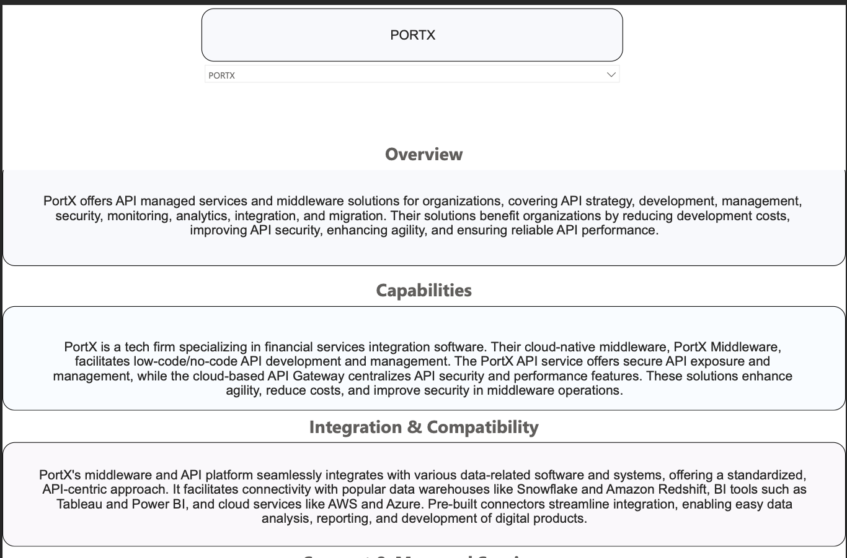
Vendor Evaluation Dashboard
Overview Page
Purpose:
Provide high level details and insights gathered from our meetings with the vendors.
How to use:
Select vendor using drop down menu in top center

Slide 39
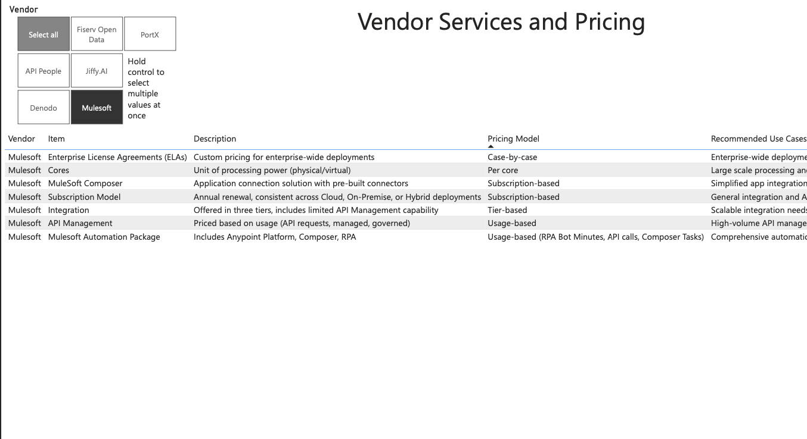
Vendor Evaluation Dashboard
Services and Pricing Page
Purpose:
Provided list of services offered by vendors and their pricing models if available
How to use:
Select the vendor you want on the top left boxes.

Slide 40
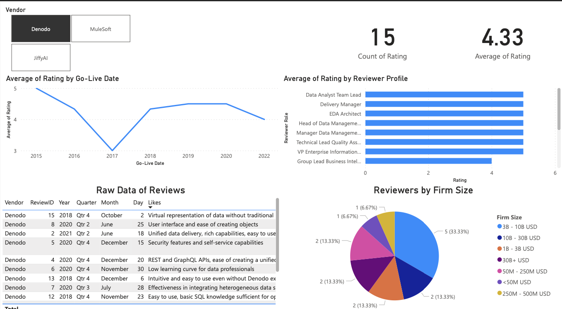
Vendor Evaluation Dashboard
Services and Pricing Page
Purpose:
Provides detailed information on reviews captured about vendors.
How to use:
Select the vendor you want on the top left boxes.

